Slide 1
Completing Reviews in PerformYard

Slide 2
There are two review schedule templates – one for Managers/Assistant Managers and one for all other employees. Templates are a collection of forms that are used for the review cycle.
These instructions will refer to the Staff template, but the same instructions apply to the Manager template with one variance that will be detailed later in these instructions.
Please note, only the manager as assigned in Gusto will see an employee on their dashboard. Anyone assigned as a contributor will not see them on their dashboard, but they can access the review forms by searching for the employee by name, clicking on Review, then clicking on the review they need to complete. To easily return to your dashboard, click on the Innowave logo at the upper left.

Slide 3
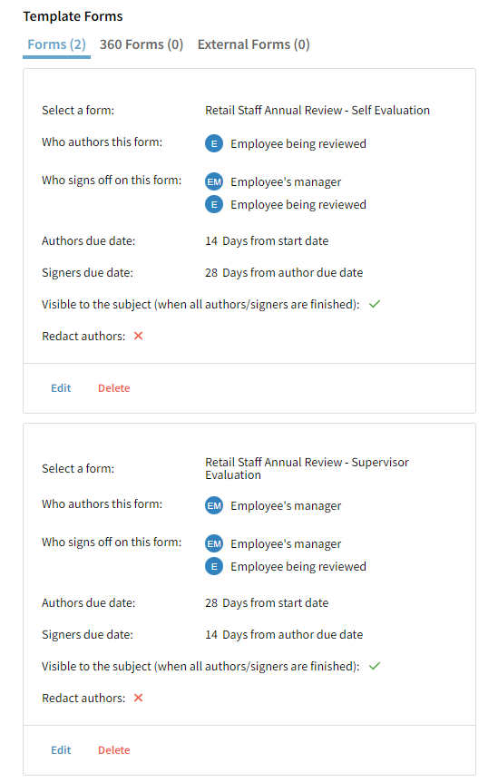
Author is the person completing the form.
Signer is the person reviewing the form and signing off to indicate it is complete.
Each form in the template has an individual set of due dates for the author and signer. Each form in the template is identical, so supervisors should be aware that any language referring to “you” when completing the supervisor evaluation is actually in reference to the employee listed on the form.
One for the employee to complete about themselves
One for the employee’s supervisor to complete about the employee.
(For the purpose of these instructions, Leah Test is an employee and Leah Wright is Leah Test’s supervisor.)

Slide 4
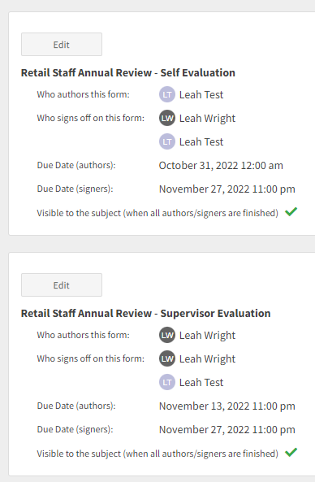
The Annual Review Cycle opens up on Sun, Oct 16 at 9am.
The employee will have until Oct 30 to complete their self review, and their supervisor will have until Nov 27 to sign off on that review. The manager can sign the self-evaluation before the review meeting.
The supervisor will have until Nov 13 to complete their review of the employee. The supervisor will also sign off on the review they complete, BUT they should not sign off until the review meeting. After the supervisor signs, the form goes back to the employee to sign. The completed review is hidden from the employee until it’s their turn to sign, so if the Supervisor signs before the review meeting, the employee will see their review before the meeting takes place.

Slide 5
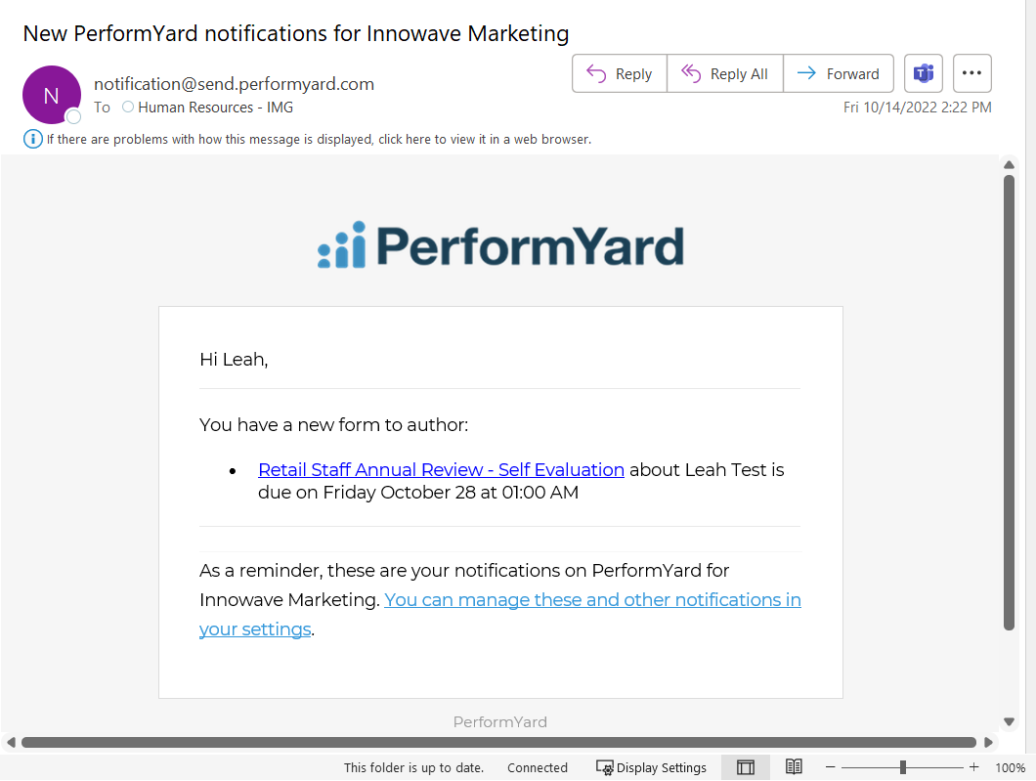
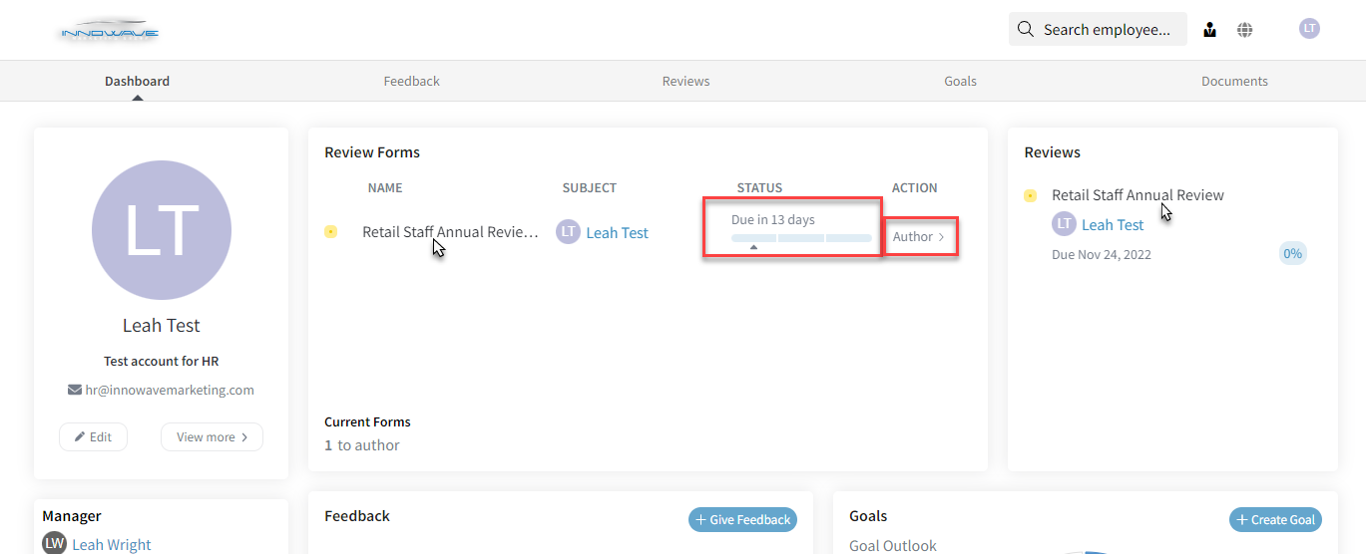
The employee will receive an email letting them know they have a new review to complete in PerformYard.
When they log in, their dashboard will show the review due, the due date, and will list them as Author. They can click the name of the review in either section to open the form.
Note: The system is very mobile friendly and will look very similar on a phone.

Slide 6
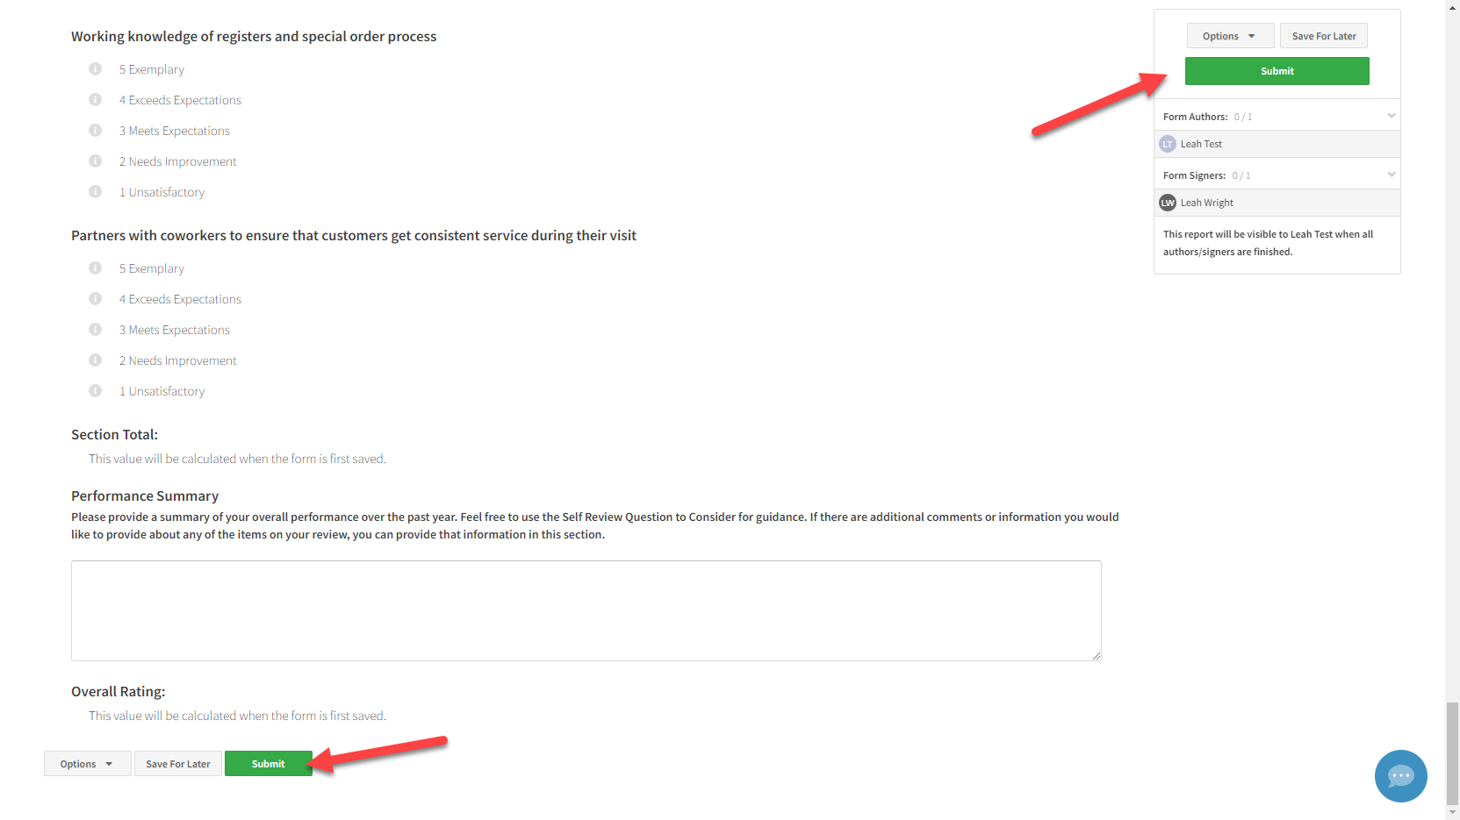
When the review is complete, the employee can click either Submit button to save and submit their review. They can also Save for Later if they are unable to finish at that time.

Slide 7
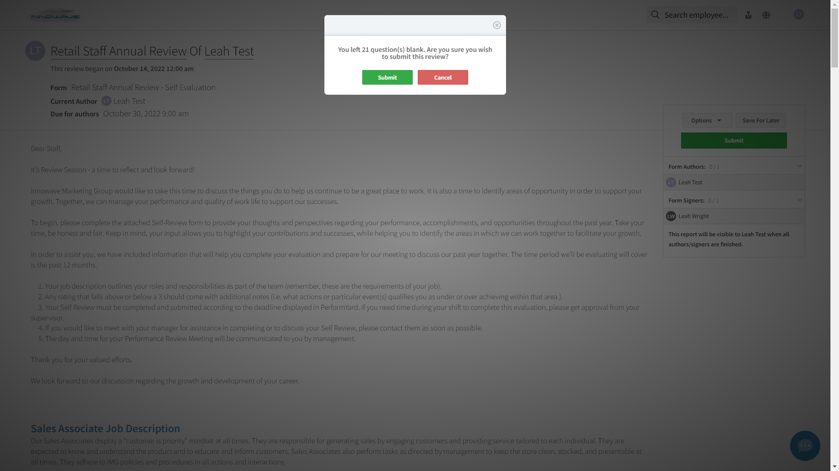
If they try to submit a review without completing all questions, the system will warn them an incomplete review is being submitted. (More on what to do if they submit an incomplete review later.)

Slide 8
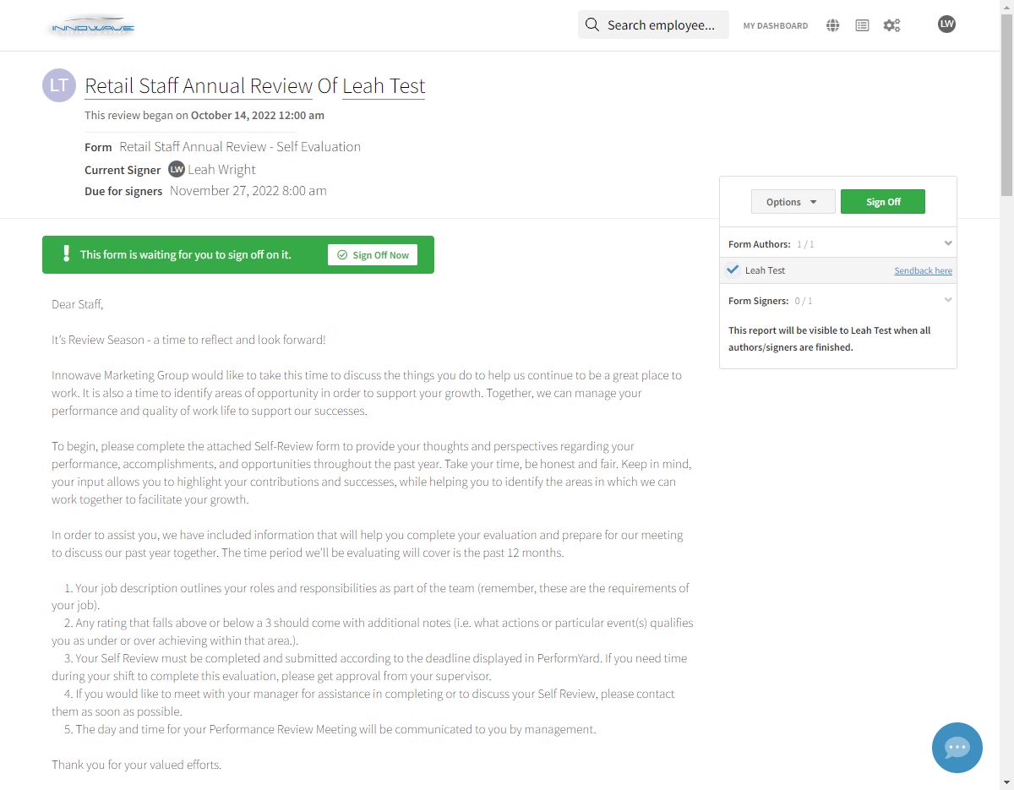
Once the employee submits their review, the supervisor will receive a notification that the review is ready for them to sign. Open the review by clicking the link in the email, clicking the link on the dashboard after signing in (employees may not always be visible on a contributor’s dashboard), or searching for the employee and clicking on Reviews, then clicking the review form that is due.

Slide 9
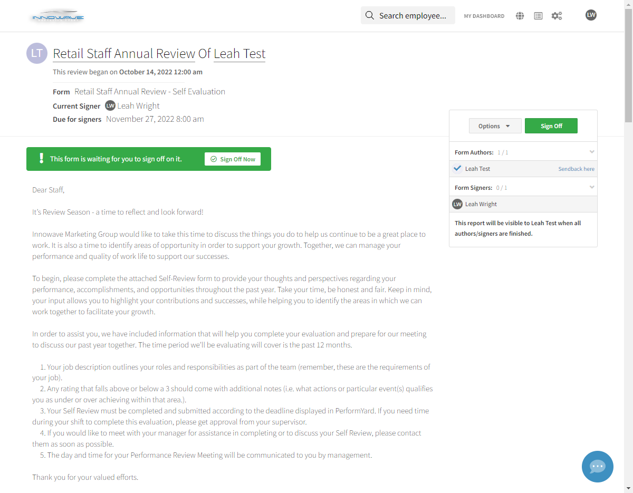
After reviewing the content of the form, if no edits are needed by the employee, click on Sign Off Now to complete the form. You will provide your specific comments regarding the employee on the Retail Staff Annual Review – Supervisor Evaluation form.

Slide 10
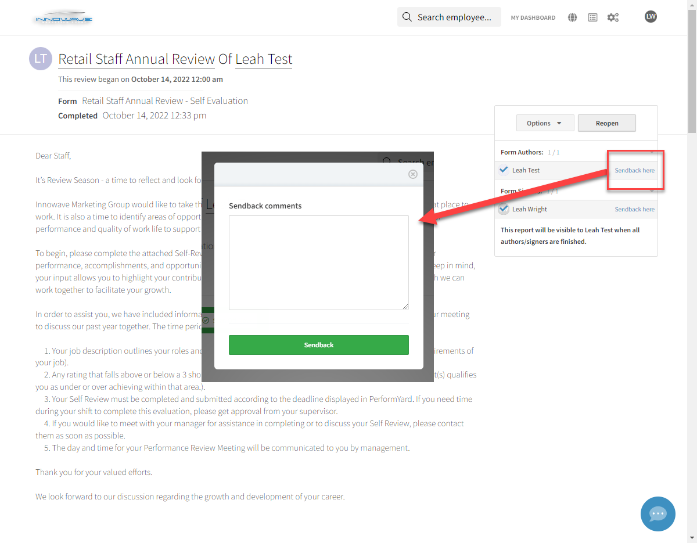
If the employee submitted an incomplete review or did not provide detail where required and you’re not ready to sign off, click on Sendback Here (you may need to click the down arrow to show the option if it is not visible), provide instructions in the comments box, and click Sendback. The employee will receive a notification to log in and complete the form that was sent back.

Slide 11
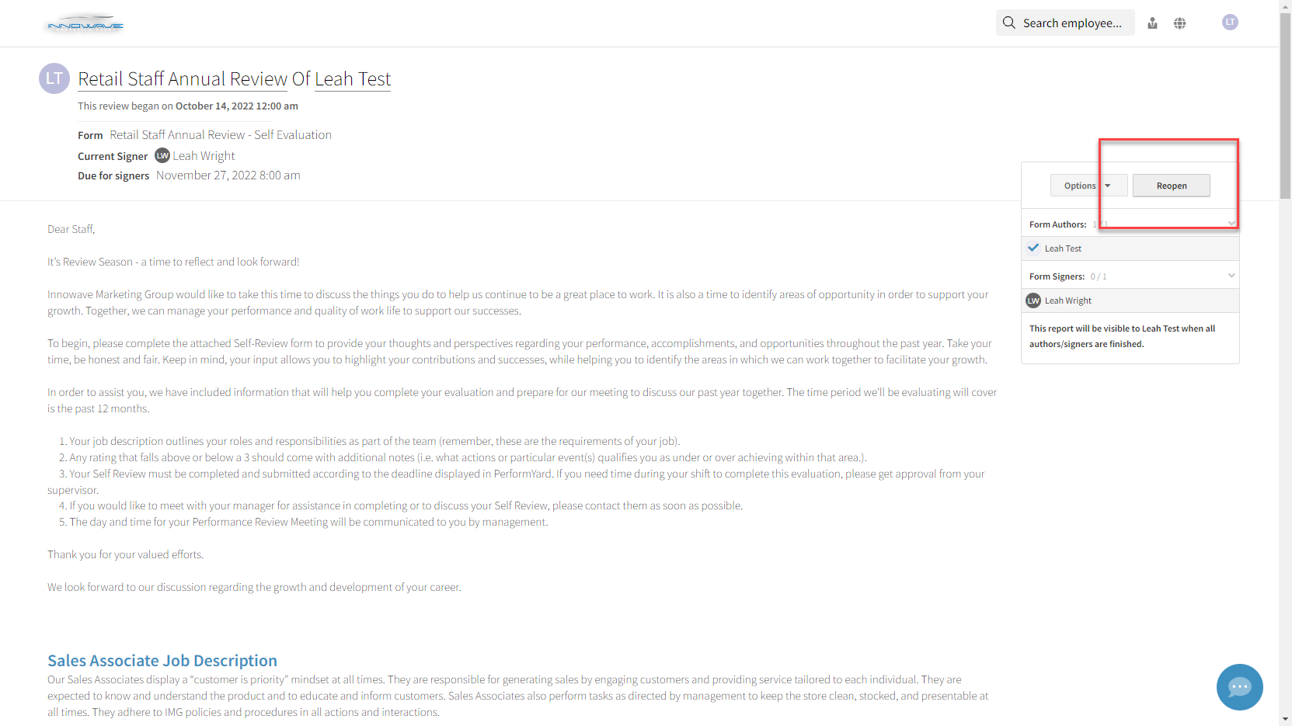
If you signed off on a form and realize it needs to be reopened or the employee has asked for it to be reopened so they can add additional details, open the completed review in PerformYard and click Reopen. Instruct the employee to also log in, open the completed review, and click Reopen. They can now make changes and resubmit the form for you to sign off again.

Slide 12
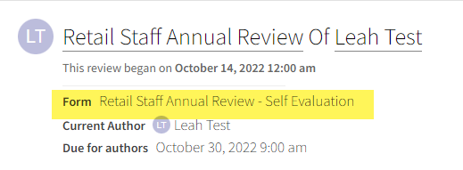
You can work on the Retail Staff Annual Review – Supervisor Evaluation at the same time as the employee is working on the Retail Staff Annual Review – Self Evaluation. They are independent forms and it is not necessary to complete one before starting the other.
Because the employee authored the Self Evaluation and already knows what it contains, you can sign it as soon as they are done with it. For the Supervisor Evaluation, you will want to wait and sign it during the review meeting so they do not see the content until you’ve had a chance to review it with them. They can then log in and sign it to acknowledge receipt of the review and have it become visible on their dashboard for historical reference.

Slide 13
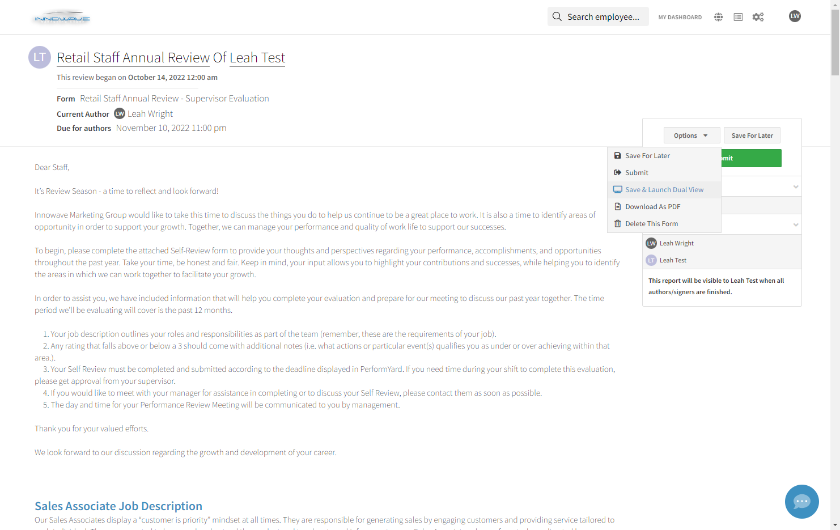
PerformYard offers a Dual View so that you can complete a review form while looking at the Self Evaluation, past reviews, feedback, etc, without needing to switch screens. To launch Dual View, click on Options, then Save & Launch Dual View (or Launch Dual View).

Slide 14
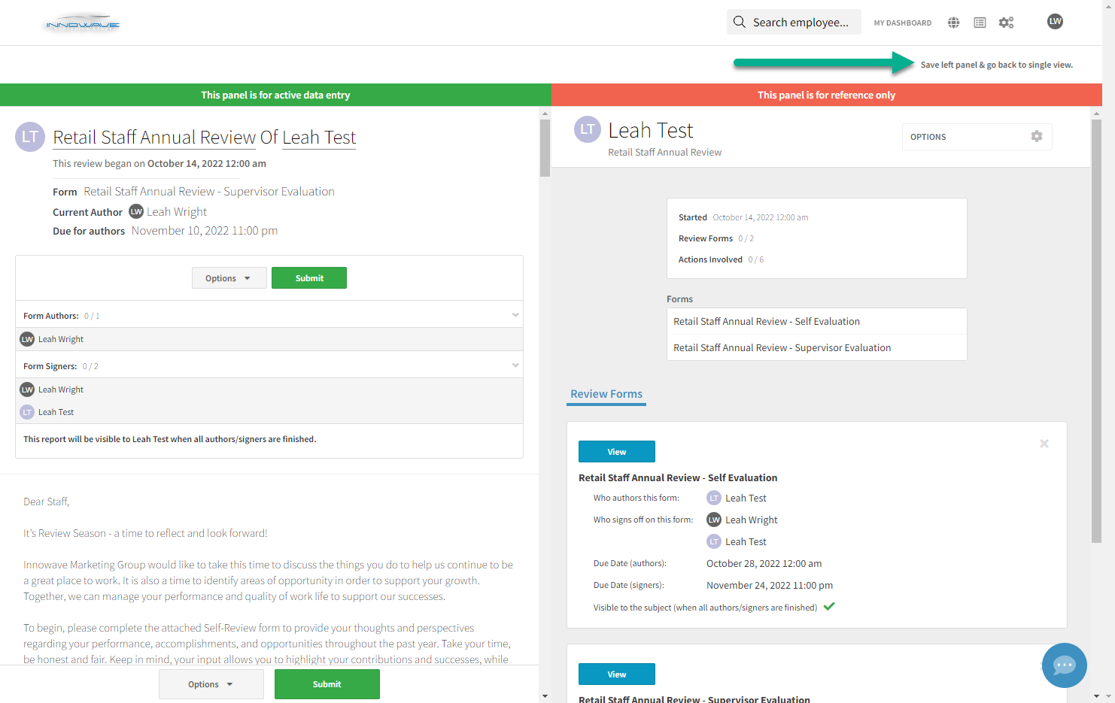
You will complete the review in the left side panel. In the right side panel, click on the employee’s name to go back to their dashboard and access any other data that exists on their profile. When you are done, click on Save left panel & go back to single view.

Slide 15
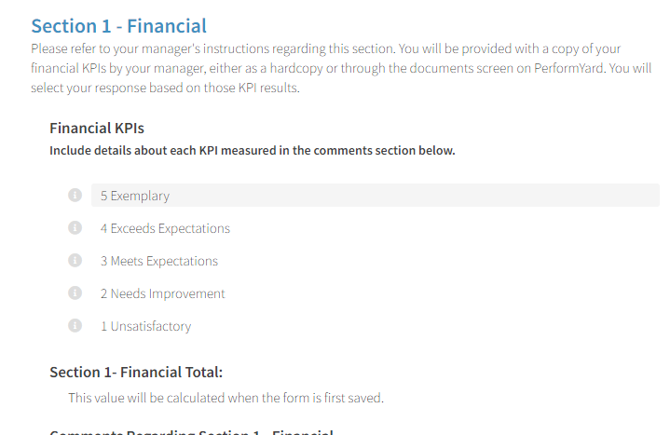
The Retail Manager Annual Review is more detailed, but very similar to the Staff form. There are two major differences.
For Section 1, the KPIs are not input into the form. Your Manager will provide further instructions, but the numbers you’ll refer to will likely be provided to you via a hardcopy, or they’ll be accessible in PerformYard by going to your Dashboard and clicking on Documents.

Slide 16
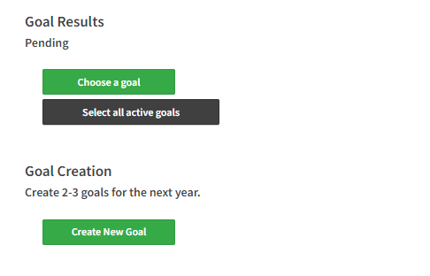
You’ll also see two questions related to Goals.
Goal Results refers to previously set goals. Goal Creation refers to new Goals for the next year.

Slide 17
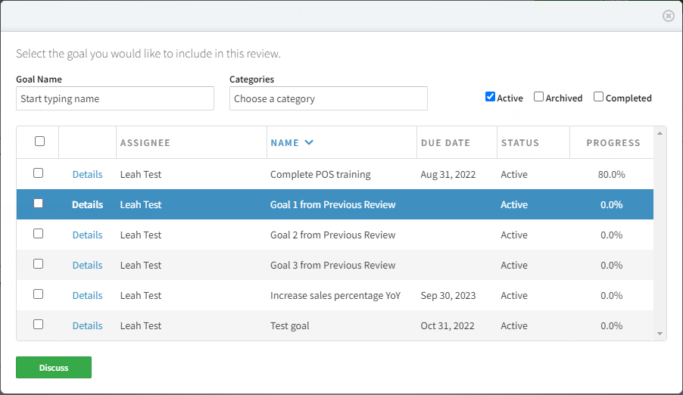
Click on Choose a goal to select on the goals you want to pull into the review or click Select all active goals to pull in all active goals at one time. If no specific goals have been entered into the system for you, you’ll see Goal 1, Goal 2, Goal 3. Interpret these as meaning any goals previously set. You can also update these goals as needed to add specific information.
These generic goals exist for all staff except for the newest employees, but they are not used on their review form at this time.

Slide 18
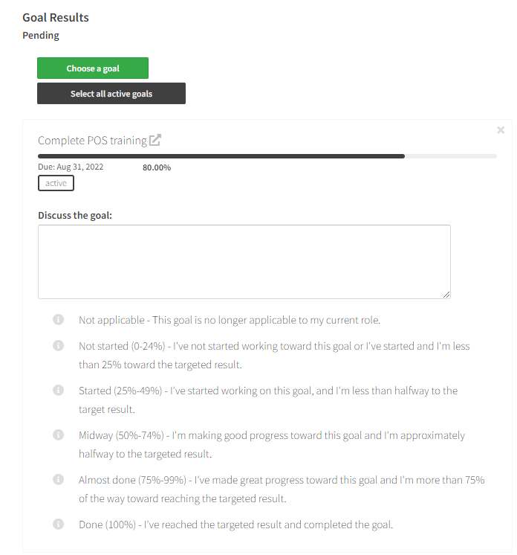
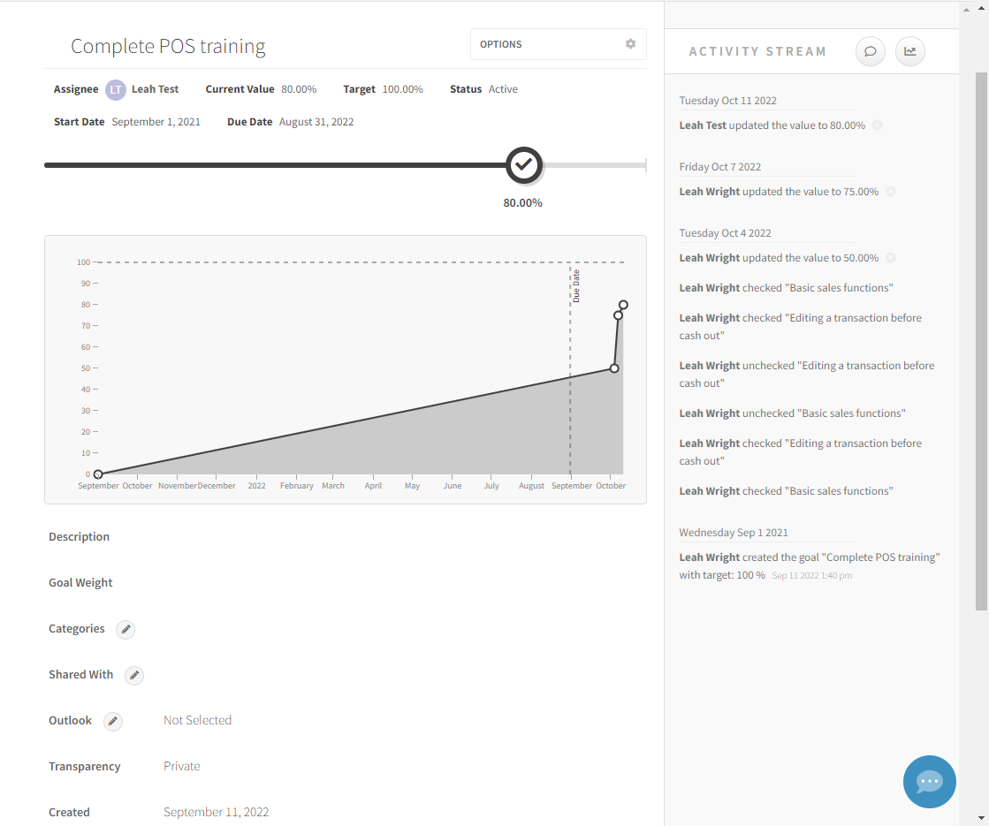
You can provide comments and a rating for each goal on the review screen or you can click the pop out button to pen the full goals screen and make more detailed updates. To mark the goal Complete, change it to 100% or click Complete under the Options button.
Note that goals for yourself or other employees can be accessed and updated at any time by going to the Goals tab on the dashboard.

Slide 19
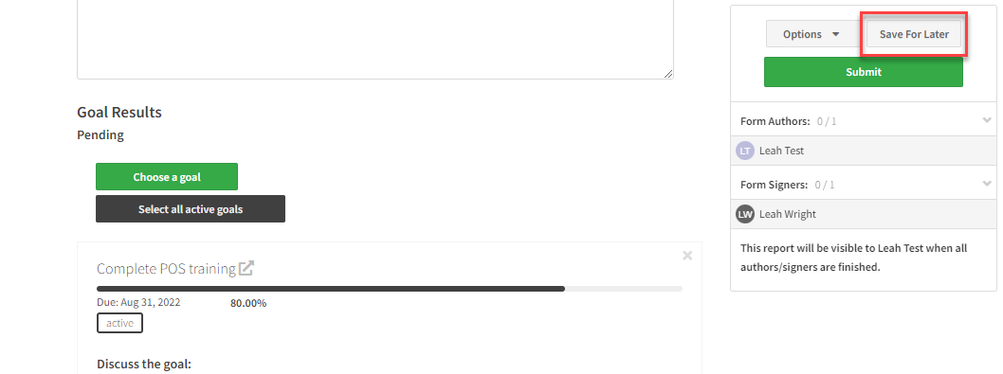
When you are done updating the information on the full Goals screen, close the tab. The changes saved during as you entered the individual updates.
If you make changes in the full Goals screen after pulling the active goals into the review, you’ll need to pull the changes into the review form. To do so, simply return to the review tab and click the Save for Later button. The form will save your previous entries, refresh but not close, and pull in the new goals information so you can continue filling out the form.

Slide 20
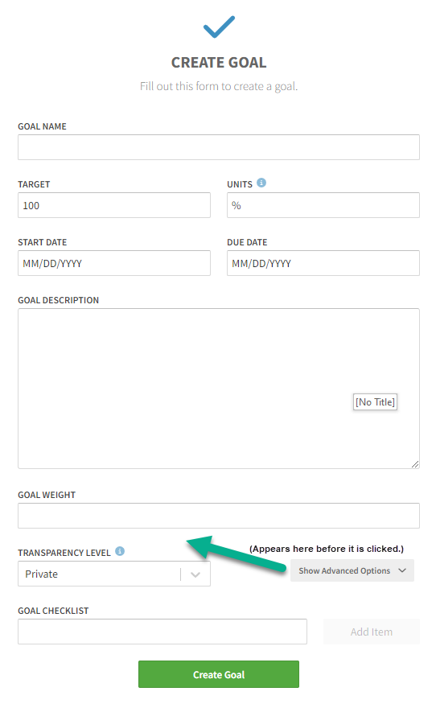
Goal Creation can take place during the Self Evaluation or the Review meeting, or at any other time during the year. To create a new goal, click the Create new goal button, give the goal a descriptive name, and set a start date. The due date is optional. You can also add a more detailed description of the goal.
If you click Show Advanced Options, you can add a checklist of specific items that apply to the goal. The transparency level should remain as Private. Changing it to Public makes the goal visible to everyone in the company. When you are done, click Create Goal.

